Slide 1
Data Aggregation and Grouping
.groupby(column) | Splits data into groups based on column values
.agg() | Applies aggregation functions to groups (sum, mean, std, count, min, max)
.transform() | Returns series with same shape as input, broadcasting group values
.filter() | Selects entire groups based on group-level condition
.apply() | Applies custom function to each group
.pivot_table() | Creates spreadsheet-style pivot table with multi-level indexing
Multiple aggregations | Pass list of function names or dict mapping columns to functions

Slide 2
Basic grouping
df.groupby('column') # Create GroupBy object
# Multiple columns
df.groupby(['col1', 'col2']) # Aggregation functions
df.groupby('column').sum() # Sum per group df.groupby('column').mean() # Mean per group df.groupby('column').count() # Count per group
# Multiple aggregations
df.groupby('column').agg(['sum', 'mean', 'std'])

Slide 3
# Custom aggregations
df.groupby('column').agg({'col1': 'sum', 'col2': 'mean'}) # Transformations
# Broadcast group mean to all rows df.groupby('column').transform('mean')

Slide 4
# Filtering groups
df.groupby('column').filter(lambda x: len(x) > 3) # Applying custom functions
df.groupby('column').apply(custom_function) # Pivot tables
df.pivot_table(values='value_col', index='row_col', columns='col_col', aggfunc='mean')

Slide 5
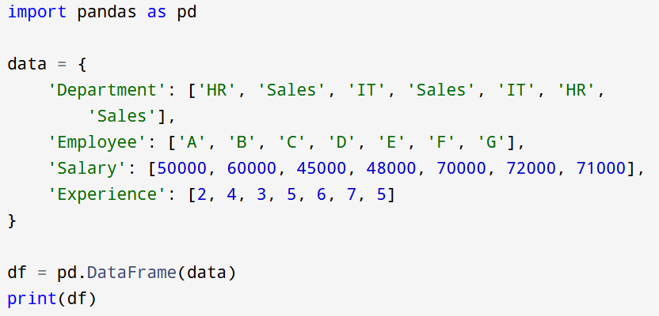
Example

Slide 6
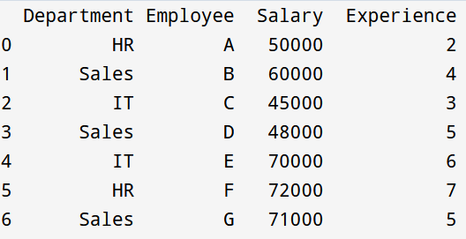
Output

Slide 7
.groupby()
Splits the DataFrame into groups based on the values of the columns you specify
Those columns become the grouping keys
By default, they become the index of the result
df.groupby(['Department', 'Experience’])
Pandas creates groups like:
(HR, 2)
(HR, 7)
(Sales, 5)
etc.

Slide 8
.sum()
df.groupby(['Department', 'Experience']).sum()
Pandas:
Looks at each group
Applies .sum() to numeric columns only
Ignores non-numeric columns automatically
Group by these columns, then perform aggregation on the remaining numeric columns.

Slide 9
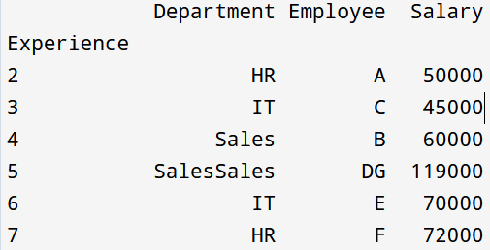
df3=df.groupby('Experience').sum()
print(df3)

Slide 10
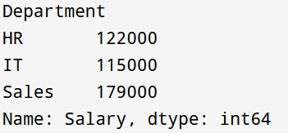
Aggregation Functions
df.groupby('Department')['Salary'].sum()

Slide 11
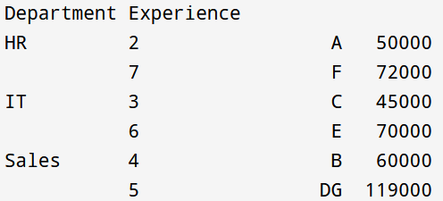
.sum()
df1=df.groupby(['Department', 'Experience']).sum()
print(df1)

Slide 12
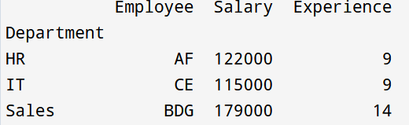
.sum()
df2=df.groupby('Department').sum()
print(df2)

Slide 13
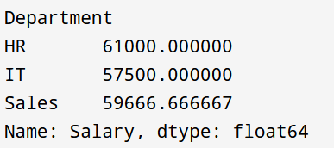
df5=df.groupby('Department')['Salary'].mean()
print(df5)

Slide 14
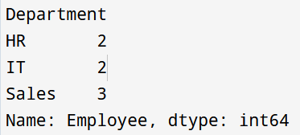
df6=df.groupby('Department')['Employee'].count()
print(df6)

Slide 15
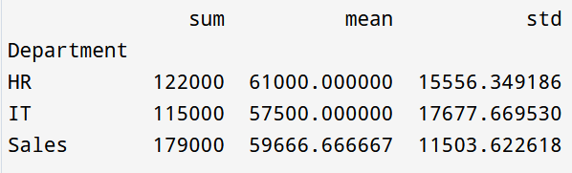
Multiple Aggregations
df7=df.groupby('Department')['Salary'].agg(['sum', 'mean', 'std’])
print(df7)

Slide 16
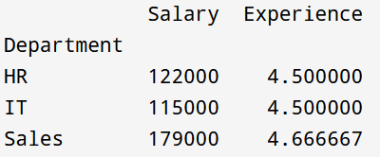
Custom Aggregations
df.groupby('Department').agg({
'Salary': 'sum', 'Experience': 'mean’
})

Slide 17
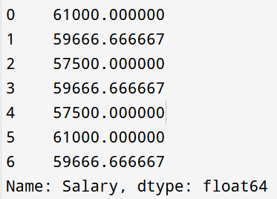
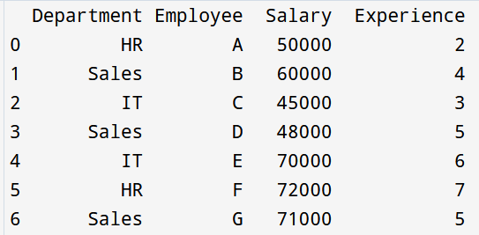
Broadcast Group Mean to Each Row
df9=df['Dept_Avg_Salary'] = df.groupby('Department')['Salary'].transform('mean’)
print(df9)

Slide 18
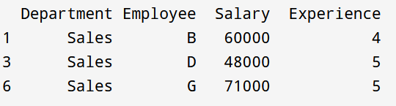
Filtering Groups
df1=df.groupby('Department').filter(lambda x: len(x) > 2)
print(df1)

Slide 19
Pivot Tables
#Mean salary by Department and Experience
df.pivot_table(
values='Salary',
index='Department',
columns='Experience',
aggfunc='mean’
)

Slide 20
Matplotlib Basic Plotting
Matplotlib is the foundational plotting library in Python, providing comprehensive tools for creating static, animated, and interactive visualizations

Slide 21
Line Plot
A line plot is used to:
Show trends over time
Show relationship between two numeric variables
Visualize continuous data
It connects data points using straight lines.
In Python, we use Matplotlib to create line plots.

Slide 22
In Python, we use Matplotlib to create line plots.
import matplotlib.pyplot as plt
#Basic Syntax of plt.plot()
plt.plot(x, y)
Where:
x → values for x-axis
y → values for y-axis

Slide 23
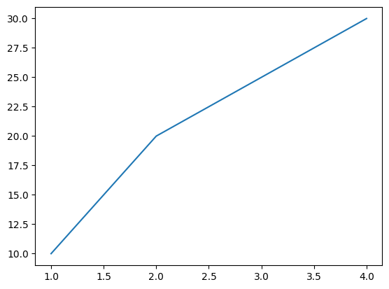
Example
x = [1, 2, 3, 4]
y = [10, 20, 25, 30]
plt.plot(x, y)
plt.show()
plt.plot(x, y, marker=None, linestyle=None, color=None, label=None)

Slide 24
Common Markers
Marker | Meaning
'o' | Circle
's' | Square
'^' | Triangle up
'v' | Triangle down
'*' | Star
'+' | Plus
'x' | X mark
'.' | Point

Slide 25

plt.plot(x, y, marker='*')

Slide 26
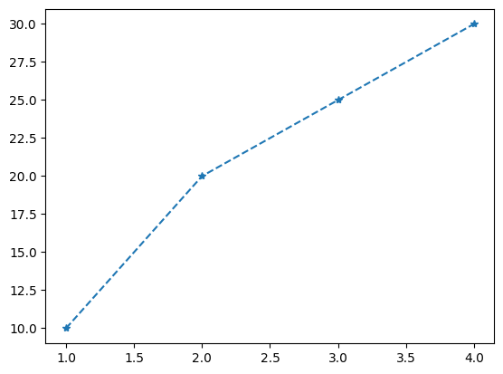
linestyle
Style | Meaning
'-' | Solid (default)
'--' | Dashed
'-.' | Dash-dot
':' | Dotted
Controls the style of the line.
plt.plot(x, y, marker=‘*’, linestyle='--')

Slide 27
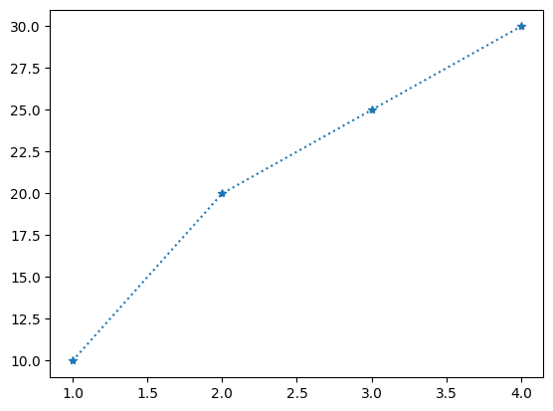
plt.plot(x, y, marker='*', linestyle=":")
plt.plot(x, y, marker='*', linestyle="dotted")

Slide 28
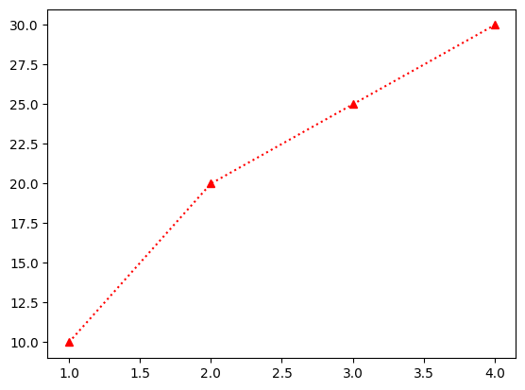
Color (Changes line color)
plt.plot(x, y, marker=“^”,linestyle=“solid”,color='blue')
Common colors:
'blue'
'red'
'green'
'black'
'yellow'
'purple'
'orange'
Hex codes: '#FF5733'
RGB tuple: (0.2, 0.5, 0.8)

Slide 29
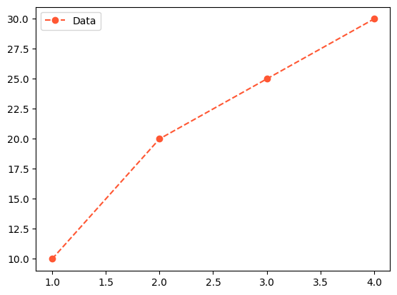
Label (Used for legend.)
#Without plt.legend(), label will not show.
plt.plot(x, y, marker='o', linestyle='--', color='#FF5733', label='Data')
plt.legend()

Slide 30
Format String Shortcut
plt.plot(x, y, marker='o', linestyle='--', color='blue’)
OR
plt.plot(x, y, 'o--b’) marker + linestyle
Code | Meaning
'r-' | Red solid line
'g--' | Green dashed
'bo' | Blue circles
'k:' | Black dotted
'r*-' | Red star solid
Format
marker + linestyle + color

Slide 31
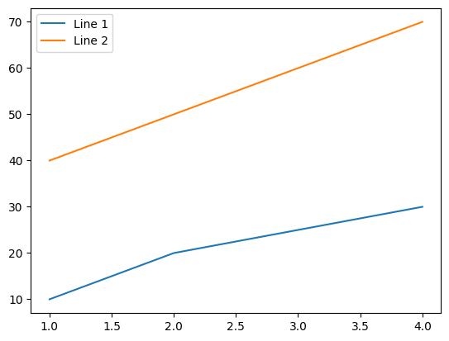
Plot Multiple Lines
import matplotlib.pyplot as plt
x = [1,2, 3, 4]
y1 = [10, 20, 25, 30]
y2 = [40, 50, 60, 70]
plt.plot(x, y1, label='Line 1')
plt.plot(x, y2, label='Line 2')
plt.legend()
plt.show()

Slide 32
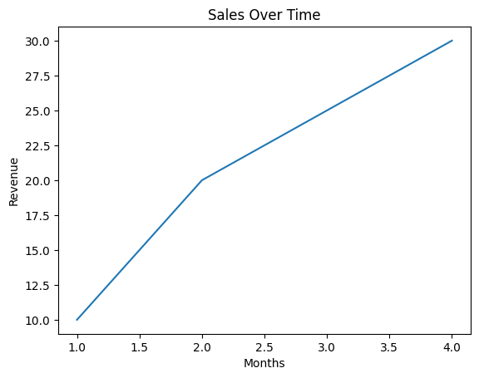
Adding Titles and Labels
plt.plot(x, y)
plt.title("Sales Over Time")
plt.xlabel("Months")
plt.ylabel("Revenue")
plt.show()

Slide 33
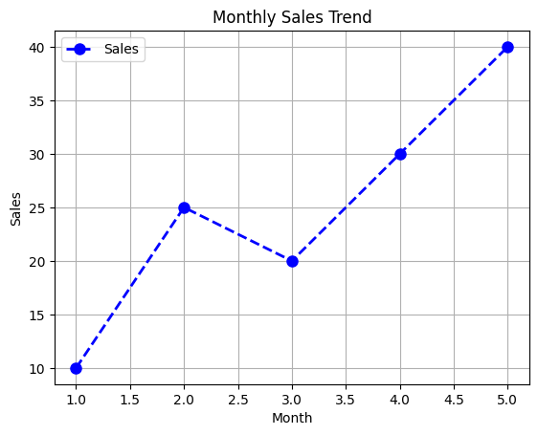
Example
import matplotlib.pyplot as plt
x = [1, 2, 3, 4, 5]
y = [10, 25, 20, 30, 40]
plt.plot(x, y, marker='o', linestyle='--', color='blue',
linewidth=2, markersize=8, label='Sales')
plt.title("Monthly Sales Trend")
plt.xlabel("Month")
plt.ylabel("Sales")
plt.legend()
plt.grid(True)
plt.show()

Slide 34
Scatter Plot
What is a Scatter Plot?
Show relationship between two numeric variables
Detect correlation
Identify clusters
Detect outliers
Basic Syntax
import matplotlib.pyplot as plt
plt.scatter(x, y)
plt.show()

Slide 35
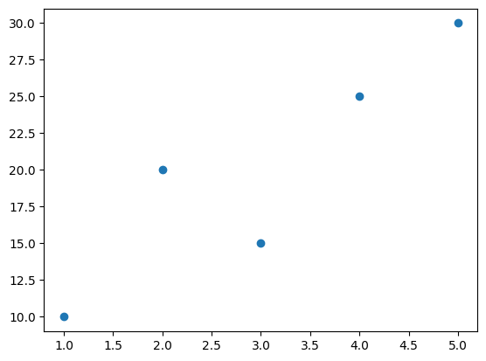
Example
import matplotlib.pyplot as plt
x = [1, 2, 3, 4, 5]
y = [10, 20, 15, 25, 30]
plt.scatter(x, y)
plt.show()

Slide 36
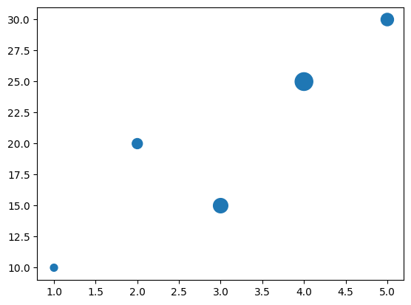
Size of Points
import matplotlib.pyplot as plt
x = [1, 2, 3, 4, 5]
y = [10, 20, 15, 25, 30]
sizes = [50, 100, 200, 300, 150]
plt.scatter(x, y, s=sizes)
plt.show()
s → Size of Points Controls marker size.
plt.scatter(x, y, s=100) s represents area, NOT radius Larger number → larger dots

Slide 37
c → Color
plt.scatter(x, y, c='blue’) #Single color
# List of colors
colors = ['red', 'blue', 'green', 'purple', 'orange’]
plt.scatter(x, y, c=colors)
#Numeric values (for colormap)
values = [1, 2, 3, 4, 5]
plt.scatter(x, y, c=values)

Slide 38
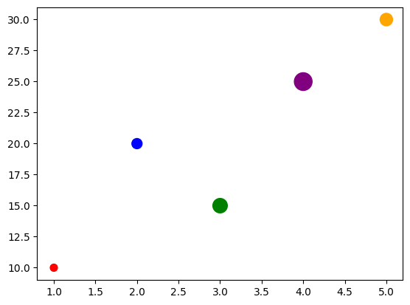
Example
import matplotlib.pyplot as plt
x = [1, 2, 3, 4, 5]
y = [10, 20, 15, 25, 30]
sizes = [50, 100, 200, 300, 150]
colors = ['red', 'blue', 'green', 'purple', 'orange']
plt.scatter(x, y,s=sizes,c=colors)
plt.show()

Slide 39
Example
import matplotlib.pyplot as plt
import numpy as np
x = np.random.rand(50)
y = np.random.rand(50)
sizes = 1000 * np.random.rand(50)
colors = np.random.rand(50)
plt.scatter(x, y, s=sizes, c=colors, cmap='viridis', alpha=0.6)
plt.colorbar()
plt.title("Advanced Scatter Plot")
plt.xlabel("X values")
plt.ylabel("Y values")
plt.show()

Slide 40
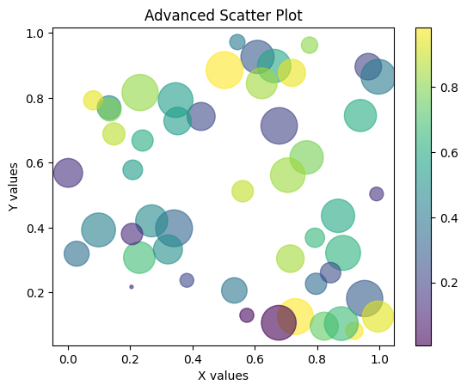

Slide 41
Method Explanations
Code Snippet | Explanation
plt.plot(x, y) | Creates a line plot. You can customize it with markers, line styles, and colors.
plt.scatter(x, y) | Creates a scatter plot with customizable point sizes and colors.
plt.bar(x, height) | Creates a vertical bar chart.
plt.hist(data, bins) | Creates a histogram to show the distribution of data using specified bins.

Slide 42
plt.xlabel() / plt.ylabel() | Sets labels for the x-axis and y-axis.
plt.title() | Sets the title of the plot.
plt.legend() | Displays a legend for labeled plot elements.
plt.grid() | Adds grid lines to improve readability.

Slide 43
plt.figure(figsize=(w, h)) | Creates a new figure with a specified size (width and height in inches).
plt.tight_layout() | Automatically adjusts subplot spacing for a cleaner layout.
plt.savefig("filename") | Saves the current figure to a file (e.g., PNG, JPG, PDF, SVG).
plt.twinx() | Creates a second y-axis that shares the same x-axis.

Slide 44
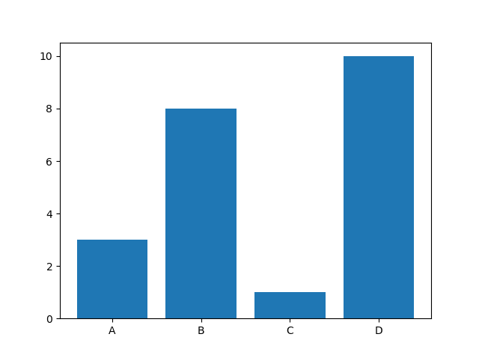
Matplotlib Bars
With Pyplot, we can use the bar() function to draw bar graphs
import matplotlib.pyplot as plt import numpy as np x = np.array(["A", "B", "C", "D"]) y = np.array([3, 8, 1, 10]) plt.bar(x,y) plt.show()

Slide 45
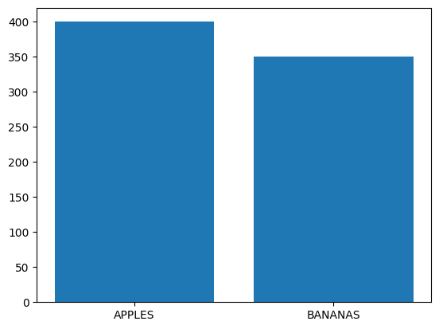
The bar() function takes arguments that describes the layout of the bars.
The categories and their values represented by the first and second argument as arrays.
import matplotlib.pyplot as plt
import numpy as np
x = ["APPLES", "BANANAS"]
y = [400, 350]
plt.bar(x, y)
plt.show()

Slide 46
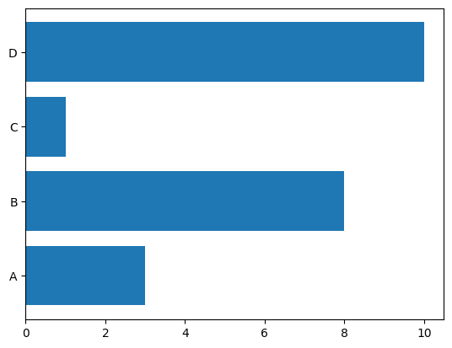
Horizontal Bars
If you want the bars to be displayed horizontally instead of vertically, use the barh() function:
import matplotlib.pyplot as plt import numpy as np x = np.array(["A", "B", "C", "D"]) y = np.array([3, 8, 1, 10]) plt.barh(x, y) plt.show()

Slide 47
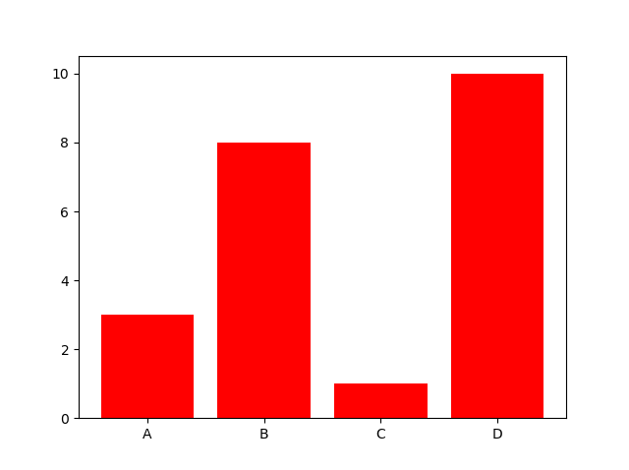
Bar Color
The bar() and barh() take the keyword argument color to set the color of the bars:
import matplotlib.pyplot as plt import numpy as np x = np.array(["A", "B", "C", "D"]) y = np.array([3, 8, 1, 10]) plt.bar(x, y, color = "red") plt.show()

Slide 48
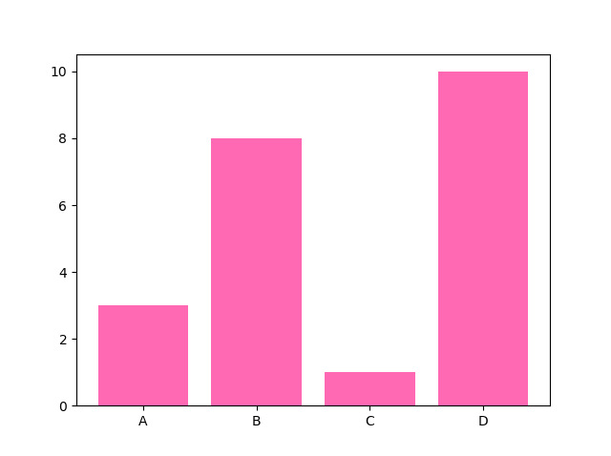
Color Names
import matplotlib.pyplot as plt import numpy as np x = np.array(["A", "B", "C", "D"]) y = np.array([3, 8, 1, 10]) plt.bar(x, y, color = "hotpink") plt.show()

Slide 49
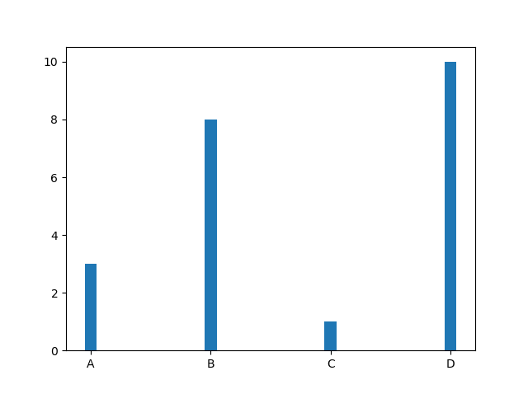
Bar Width
The bar() takes the keyword argument width to set the width of the bars:
import matplotlib.pyplot as plt import numpy as np x = np.array(["A", "B", "C", "D"]) y = np.array([3, 8, 1, 10]) plt.bar(x, y, width = 0.1) plt.show()

Slide 50
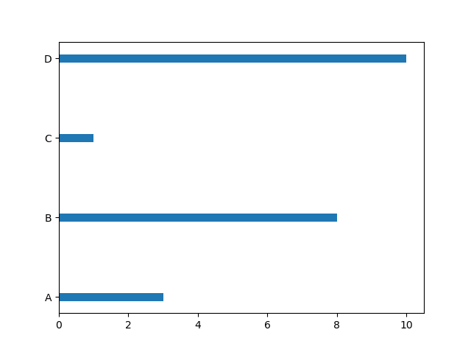
Bar Height
The barh() takes the keyword argument height to set the height of the bars:
import matplotlib.pyplot as plt import numpy as np x = np.array(["A", "B", "C", "D"]) y = np.array([3, 8, 1, 10]) plt.barh(x, y, height = 0.1) plt.show()

Slide 51
Chart Type | Thickness Parameter
plt.bar() (vertical) | width
plt.barh() (horizontal) | height

Slide 52
Matplotlib Histograms
A histogram is a graph showing frequency distributions. Or A histogram shows the distribution of numerical data by grouping values into ranges (bins).
It is a graph showing the number of observations within each given interval.
In Matplotlib, we use the hist() function to create histograms.
The hist() function will use an array of numbers to create a histogram, the array is sent into the function as an argument.
The hist() function will read the array and produce a histogram:
import numpy as np
x = np.random.normal(170, 10, 250)
print(x)

Slide 53
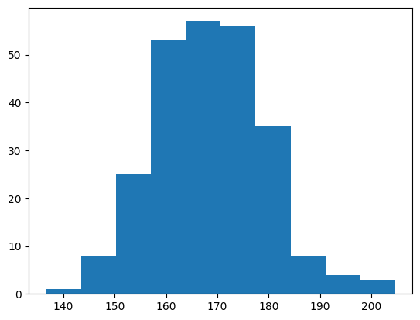
import matplotlib.pyplot as plt import numpy as np x = np.random.normal(170, 10, 250) plt.hist(x) plt.show()

Slide 54
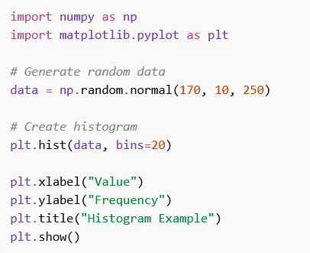
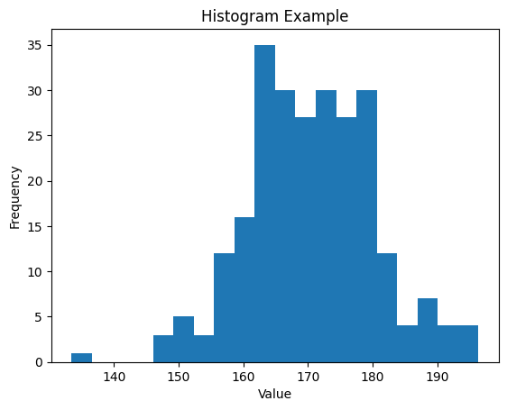
Example

Slide 55
Basic Syntax
plt.hist(data, bins)
data → Numeric dataset (list or array)
bins → Number of intervals (or specific bin edges)

Slide 56
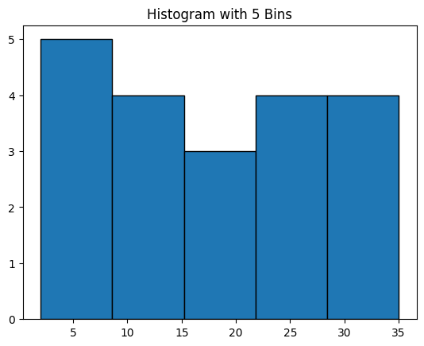
import matplotlib.pyplot as plt
data = [2, 4, 5, 7, 8,
10, 12, 13, 15, 17,
18, 20, 22, 24, 25,
27, 29, 30, 32, 35]
plt.hist(data, bins=10, edgecolor="black")
plt.title("Histogram with 5 Bins")
plt.show()
So bins are approximately:
2 – 8
8 – 15
15 – 22
22 – 29
29 – 35
How the bins are divided:
Range = 35 − 2 = 33 33 ÷ 5 ≈ 6.6 per bin
Fewer bins = wider bars = less detail

Slide 57
Approximate bins:
2–8 → values: 2, 4, 5, 7, 8 → 5 values
8–15 → 10, 12, 13, 15 → 4 values
15–22 → 17, 18, 20, 22 → 4 values
22–29 → 24, 25, 27, 29 → 4 values
29–35 → 30, 32, 35 → 3 values

Slide 58
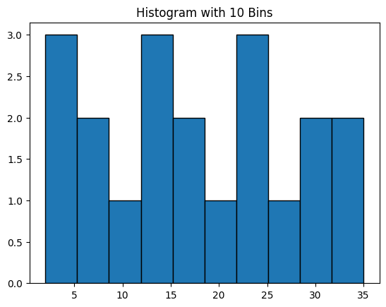
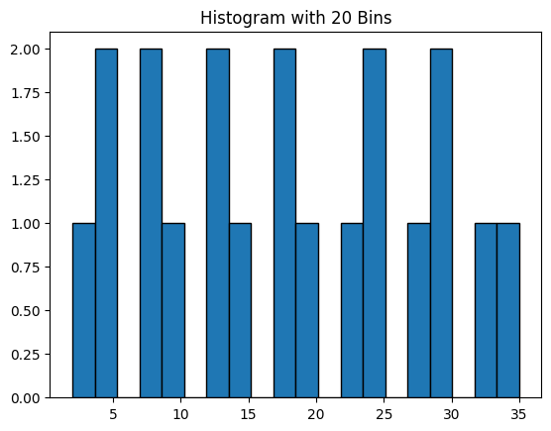

Slide 59
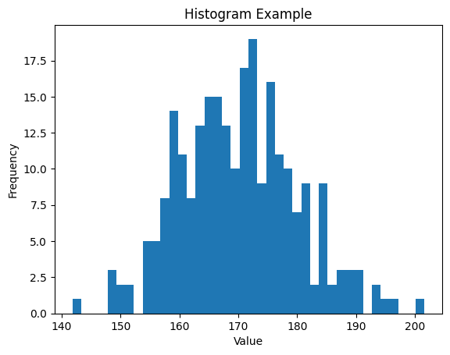
import numpy as np
import matplotlib.pyplot as plt
# Generate random data
data = np.random.normal(170, 10, 250)
# Create histogram
plt.hist(data, bins=40)
plt.xlabel("Value")
plt.ylabel("Frequency")
plt.title("Histogram Example")
plt.show()

Slide 60
Parameter | Purpose
bins=20 | Number of bars (intervals)
color="blue" | Bar color
edgecolor="black" | Border color of bars
alpha=0.5 | Transparency (0–1)
density=True | Shows probability density instead of frequency
range=(min, max) | Limits the data range

Slide 61
import matplotlib.pyplot as plt
data = [
30, 35, 40, 42, 45, 47, 48, 49,
50, 50, 51, 52, 53, 55, 57, 60,
62, 65, 70, 75
]
plt.figure(figsize=(8, 5))
plt.hist(
data,bins=5,color="blue",
edgecolor="black",
alpha=0.5,density=True,
range=(30, 80)
)
plt.xlabel("Value")
plt.ylabel("Density")
plt.title("Histogram Without Random Data")
plt.grid(True)
plt.tight_layout()
plt.show()

Slide 62
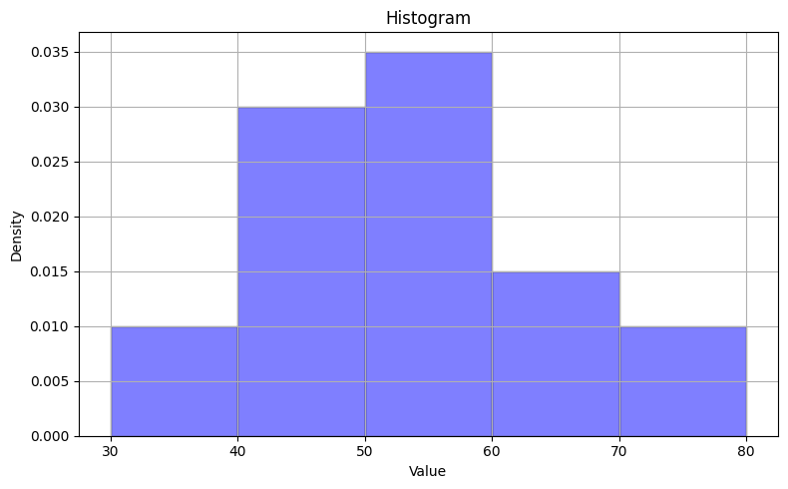

Slide 63
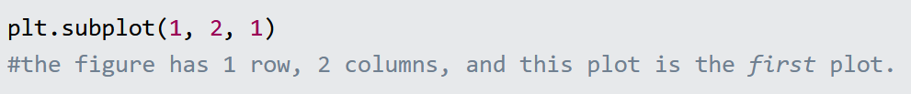
Matplotlib Subplot
Display Multiple Plots
With the subplot() function you can draw multiple plots in one figure:
The subplot() function takes three arguments that describes the layout of the figure.
The layout is organized in rows and columns, which are represented by the first and second argument.
The third argument represents the index of the current plot.

Slide 64
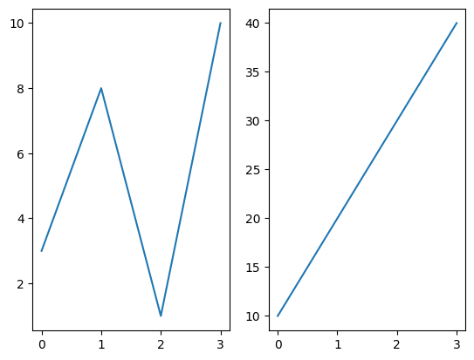
import matplotlib.pyplot as plt
import numpy as np
#plot 1:
x = np.array([0, 1, 2, 3])
y = np.array([3, 8, 1, 10])
plt.subplot(1, 2, 1)
plt.plot(x,y)
#plot 2:x = np.array([0, 1, 2, 3])
y = np.array([10, 20, 30, 40])
plt.subplot(1, 2, 2)
plt.plot(x,y)
plt.show()

Slide 65
Draw 2 plots on top of each other:
import matplotlib.pyplot as plt import numpy as np #plot 1: x = np.array([0, 1, 2, 3]) y = np.array([3, 8, 1, 10]) plt.subplot(2, 1, 1) plt.plot(x,y) #plot 2: x = np.array([0, 1, 2, 3]) y = np.array([10, 20, 30, 40]) plt.subplot(2, 1, 2) plt.plot(x,y) plt.show()

Slide 66
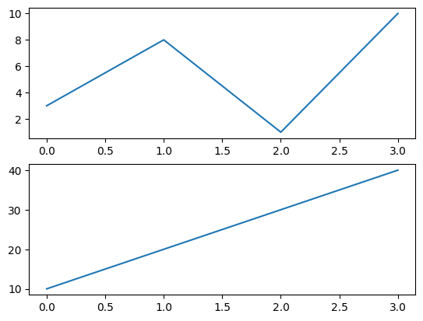

Slide 67
import matplotlib.pyplot as plt import numpy as np x = np.array([0, 1, 2, 3]) y = np.array([3, 8, 1, 10]) plt.subplot(2, 3, 1) plt.plot(x,y) x = np.array([0, 1, 2, 3]) y = np.array([10, 20, 30, 40]) plt.subplot(2, 3, 2) plt.plot(x,y)
x = np.array([0, 1, 2, 3]) y = np.array([3, 8, 1, 10]) plt.subplot(2, 3, 3) plt.plot(x,y)
x = np.array([0, 1, 2, 3]) y = np.array([10, 20, 30, 40]) plt.subplot(2, 3, 4) plt.plot(x,y) x = np.array([0, 1, 2, 3]) y = np.array([3, 8, 1, 10]) plt.subplot(2, 3, 5) plt.plot(x,y) x = np.array([0, 1, 2, 3]) y = np.array([10, 20, 30, 40]) plt.subplot(2, 3, 6) plt.plot(x,y) plt.show()

Slide 68
